Slide 1
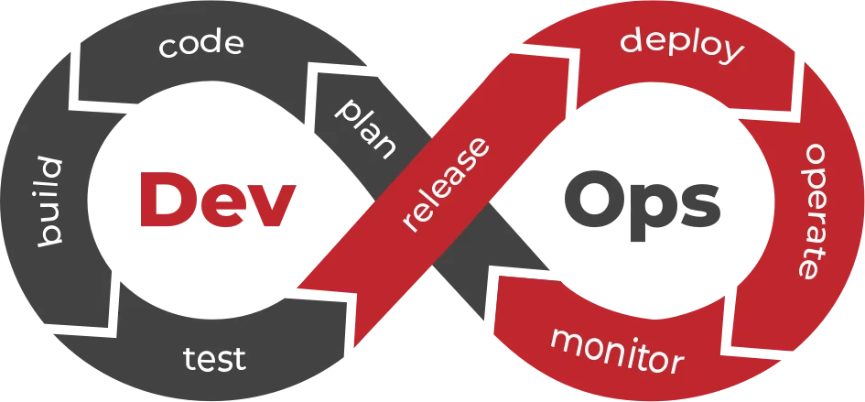
DevOps Project​
Automated process of deploying site on Amazon Web Services​ Elastic Beanstalk
Tetiana Dinkievych​
Epam
DevOps_online_Dnipro_2021

Slide 2









Тechnologies used

Slide 3

Deploy
Build

Slide 4
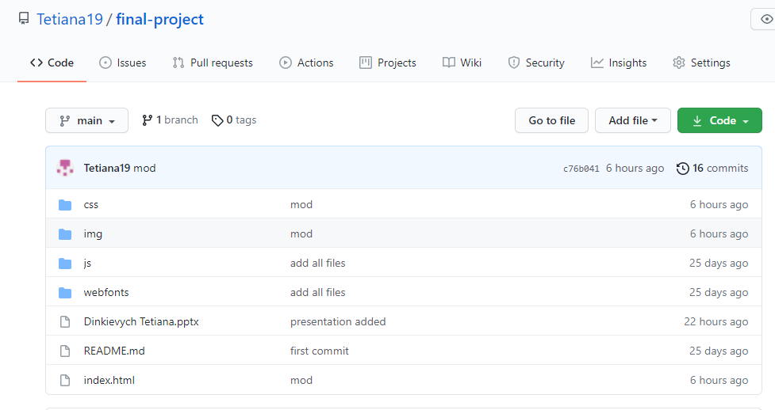
What we did on github?

Slide 5
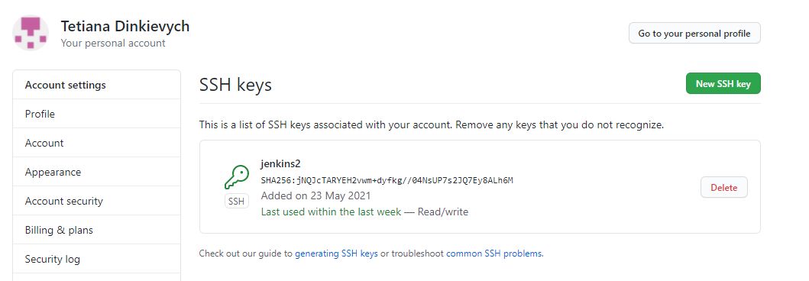
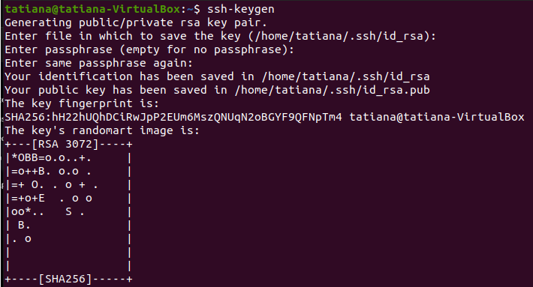
Ssh keys

Slide 6
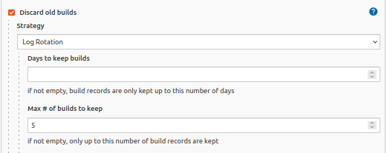
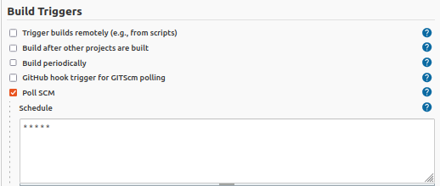
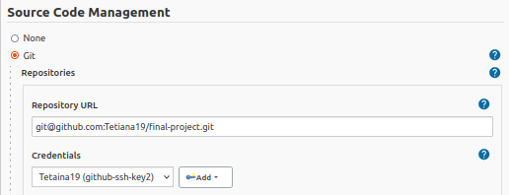
What we did on Jenkins?

Slide 7
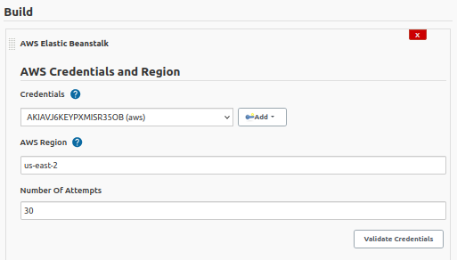
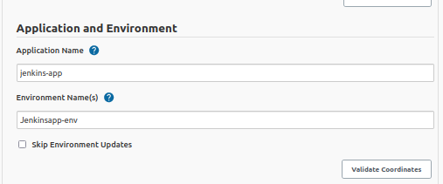

Slide 8
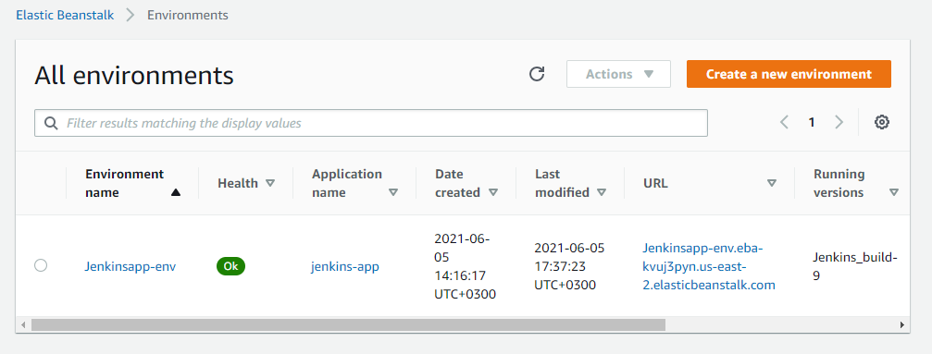
What we did on AWS?

Slide 9

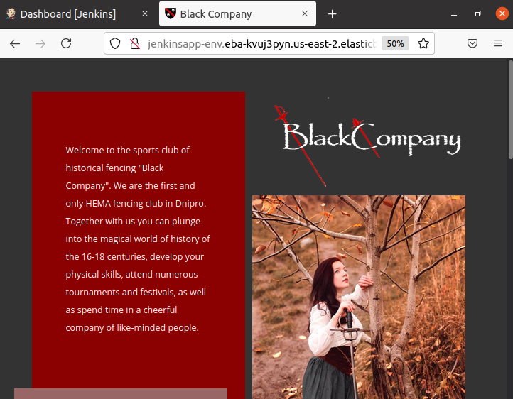

Slide 10
Thanks
you for
attention

